Slide 1
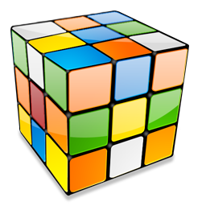
Combinatorial Problems
Permutations, Variations, Combinations and N choose K
SoftUni Team
Technical Trainers
Software University
https://softuni.bg

Slide 2
Have a Question?
sli.do
#Algorithms-CSharp

Slide 3
Table of Contents
Permutations
Variations
Combinations
N Choose K Count
3

Slide 4
Permutations

Slide 5
Permutations
Permutation of a set is an arrangement of its members into a sequence or linear order
If the set is already ordered, a rearrangement of its elements
There are two types of permutations
Without repetition
With repetition

Slide 6
Permutations
Order A, B and C in all possible ways
A
B
C

Slide 7
Permutations
Order A, B and C in all possible ways
A
B
C
A | B
A | C
B | A
B | C
C | A
C | B

Slide 8
Permutations
Order A, B and C in all possible ways
A
B
C
A | B
A | C
B | A
B | C
C | A
C | B
A | B | C
A | C | B
B | A | C
B | C | A
C | A | B
C | B | A

Slide 9
Problem: Generate Permutations
Generates all possible permutations of a given set of elements
You can pick each item only once
A B C
A C B
B A C
B C A
C A B
C B A
A B C

Slide 10
Algorithm: Permutations
Algorithm permute(index) to generate variations P(n)
Put unused elements 0 … n-1 at position index
Mark/unmark elements as being used
Call permute(index + 1) to generate the rest of the array
permute(0)
permute(1)
permute(n)
print(); stop();
0… n - 1 | x | x | x | x
y
0… n - 1 | x | x | x | x
unused
unused
permute(1)
permute(2)

Slide 11
Generating Permutations
static void Permute(int index)
{
if (index >= permutations.Length)
Print();
else
for (int i = 0; i < elements.Length; i++) {
if (!used[i]) {
used[i] = true;
permutations[index] = elements[i];
Permute(index + 1);
used[i] = false;
}
}
}

Slide 12
Permutations Count
Order A, B and C in all possible ways
How many ways are there?
A | B | C
3
2
1
n! = 3!
6 possible ways

Slide 13
Problem: Optimize Permutations
Generates all possible permutations of a given set of elements
Without using extra memory
A B C
A C B
B A C
B C A
C A B
C B A
A B C

Slide 14
Generating Permutations
static void Permute(int index)
{
if (index >= elements.Length)
Print();
else {
Permute(index + 1);
for (int i = index + 1; i < elements.Length; i++) {
Swap(index, i);
Permute(index + 1);
Swap(index, i);
}
}
}

Slide 15
Problem: Permutations with Repetition
What about array = new [] { A, B, B }
By definition: permutations { A, B', B'' } == { A, B'', B' }
Generate all permutations from a multi-set
A B B
B A B
B B A
A B B

Slide 16
Solution: Permutations with Repetition
static void Permute(int index) {
if (index >= elements.Length)
Print();
else {
Permute(index + 1);
var swapped = new HashSet<string> { elements[index] };
for (int i = index + 1; i < elements.Length; i++) {
if (!swapped.Contains(elements[i])) {
Swap(index, i);
Permute(index + 1);
Swap(index, i);
swapped.Add(elements[i]);
}
}
}
}

Slide 17
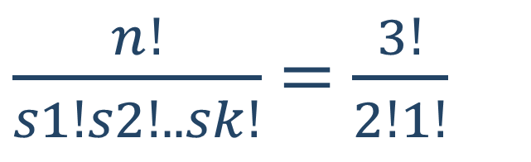
Permutations with Repetition Count
Order A, B and B in all possible ways
In how many ways we can do that?
A | B | B
$\frac{n!}{s1!s2!..sk!}$ = $\frac{3!}{2!1!}$
3 different ways

Slide 18
Variations

Slide 19
Variations
Order A, B and C in all possible ways int k slots
Pick each item only once
A
B
C

Slide 20
Variations
Order A, B and C in all possible ways int k slots
Pick each item only once
A
B
C
A | B
A | C
B | A
B | C
C | A
C | B

Slide 21
Problem: Generate Variations
Generates all possible variations of k from a set of elements
You can pick an item once
A B
A C
B A
B C
C A
C B
A B C
2

Slide 22
Generating Variations
static void Variations(int index)
{
if (index >= variations.Length)
Print();
else
for (int i = 0; i < elements.Length; i++) {
if (!used[i]) {
used[i] = true;
variations[index] = elements[i];
Variations(index + 1);
used[i] = false;
}
}
}

Slide 23

Variations Count
Order two from A, B, C and D in all possible ways
How many ways are there?
A | B | C | D
Multiply
4
3
$\frac{n!}{(n−k)!}$ = $\frac{4!}{2!}$
Twelve different ways

Slide 24
Variations with Repetitions
Order A, B and C in all possible ways into k slots
You can pick an item multiple times
A
B
C
A | A
A | B
B | A
B | B
C | A
C | B
A | C
B | C
C | C

Slide 25
Problem: Generate Variations with Reps
Generates all possible variations of a given elements
You can pick an item multiple times
A A
A B
A C
B A
B B
B C
C A
C B
C C
A B C
2

Slide 26
Generating Permutations
static void Variations(int index)
{
if (index >= variations.Length) {
Print();
}
else {
for (int i = 0; i < elements.Length; i++) {
variations[index] = elements[i];
Variations(index + 1);
}
}
}

Slide 27
Variations with Reps: Iterative Algorithm
Generating the variations for n = 3 and k = 2
A | A
B | A
C | A
A | B
B | B
C | B
A | C
B | C
C | C

Slide 28
Variations with Reps: Iterative Algorithm
while (true) {
Print(arr);
int index = k - 1;
while (index >= 0 && arr[index] == n-1)
index--;
if (index < 0)
break;
arr[index]++;
for (int i = index + 1; i < k; i++)
arr[i] = 0;
}
int n = 5;
int k = 3;
int[] arr = new int[k];
(0, 0, 0)
(0, 0, 1)
…
(4, 4, 2)
(4, 4, 3)
(4, 4, 4)

Slide 29
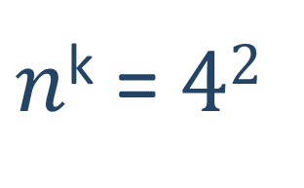
Variations Count
Order two from A, B, C and D in all possible ways
How many ways are there?
A | B | C | D
Multiply
4
4
Sixteen different ways
$n$^{k} = $42$

Slide 30

$$\frac{n!}{k!\left(n−k\right)! }$$
Combinations

Slide 31
Combinations
Pick two form A, B and C
Order does not matter
A
B
C
A | B
A | C
B | C

Slide 32
Problem: Generate Combinations
Generates all possible combinations from a given elements
You can pick each item only once
A B
A C
B C
A B C
2

Slide 33
Combinations without Repetition
static void Combinations(int index, int start)
{
if (index >= slots.Length)
Print();
else {
for (int i = start; i < elements.Length; i++) {
slots[index] = elements[i];
Combinations(index + 1, i + 1);
}
}
}

Slide 34
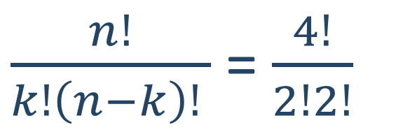
Combinations Count
Pick two from {A, B, C, D} in all possible ways, order does not matter
How many ways are there?
4
3
Variations n = 4, k = 2
2
1
Permutations of n = 2
$\frac{n!}{k!\left(n−k\right)! }$ = $\frac{4!}{2!2!}$
6 different ways

Slide 35
Algorithm: Combinations with Repetition
Generating the combinations for n = 3 and k = 2
A | A
B | B
C | C
A | B
B | C
A | C

Slide 36
Generate Combinations with Repetition
static void Combinations(int index, int start)
{
if (index >= slots.Length)
Print();
else {
for (int i = start; i < elements.Length; i++) {
slots[index] = elements[i];
Combinations(index + 1, i);
}
}
}

Slide 37


N Choose K Count

Slide 38
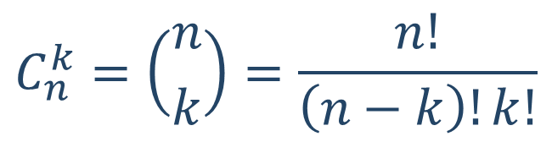
Problem: Combinations Count
How many combinations we have when n = 16, k = 15?
Solution:
How many ways to pick 15 items?
16 * 15 * 14 * … * 2
Divide by the number of ways in which you can arrange 15 numbers
15 * 14 * 13 * … * 1
Possible combinations → 16
$$C_{n}^{k}=\left({n \atop k}\right)=\frac{n!}{\left(n−k\right)!k!}$$

Slide 39
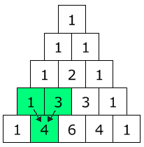
Pascal's Triangle
In how many ways each node can be reached?
Quickly find N choose K count
Go down to row n (the top row is 0)
Move along k places to the right
n = 4
k = 1

Slide 40
Binomial Coefficients: Calculation
static long Binom(int n, int k)
{
if (n <= 1)
return 1;
if (k == 0 || k == n)
return 1;
return Binom(n - 1, k) + Binom(n - 1, k - 1);
}

Slide 41

Summary
…
…
…
Permutations – Ways to order n elements
Variations – Ways to order k of n elements
Combinations – Ways to choose k of n elements
Pascal's Triangle
Binomial Coefficients – N choose K Count

Slide 42
Questions?

Slide 43












SoftUni Diamond Partners

Slide 44


Educational Partners

Slide 45

License
This course (slides, examples, demos, exercises, homework, documents, videos and other assets) is copyrighted content
Unauthorized copy, reproduction or use is illegal
© SoftUni – https://about.softuni.bg/
© Software University – https://softuni.bg
Notes:
45

Slide 46





Trainings @ Software University (SoftUni)
Software University – High-Quality Education, Profession and Job for Software Developers
softuni.bg
Software University Foundation
http://softuni.foundation
Software University @ Facebook
facebook.com/SoftwareUniversity
Software University Forums
forum.softuni.bg

